Slide 1
ReactJS
Training to develop application with reactjs

Slide 2
Title of content
What is ES6
Intro to ReactJS
Just React - Hello World
Folder structure
Component Types

Slide 3
What is ES6?
ECMAScript 6 is also known as ES6 and ECMAScript 2015 . Some people like to call it JavaScript 6.
Block scope, let & const
Template literals
Arrow functions
Spread and Rest operators
Object literal improvements
Classes
Inheritance
Static properties and methods
Promises

Slide 4
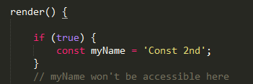
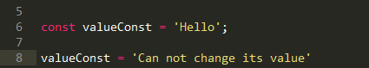
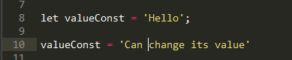
Block scope, let & const

Slide 5
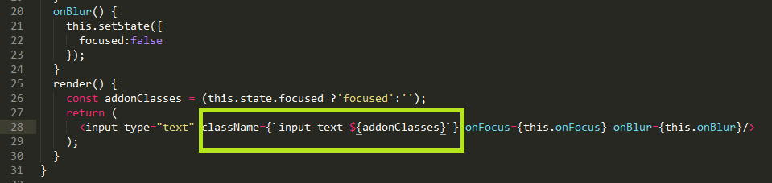
Template literals

Slide 6
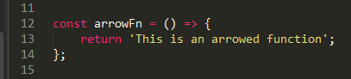
Arrowed (functions)

Slide 7
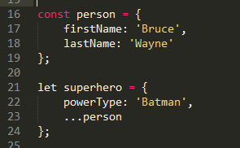
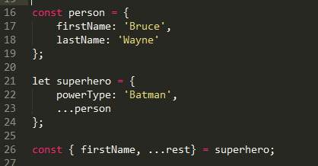
Spread and Rest operators
Person:{"firstName":"Bruce","lastName":"Wayne"}
Superhero:{"powerType":"Batman","firstName":"Bruce","lastName":"Wayne"}
firstName:Bruce
rest:{"powerType":"Batman","lastName":"Wayne"}

Slide 8
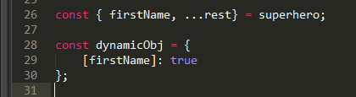
Object literal improvements
{“Bruce”:true}

Slide 9
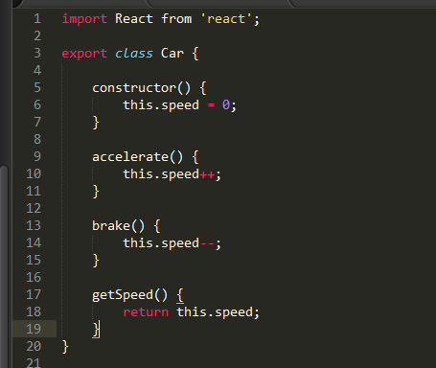
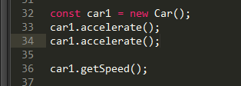
Classes

Slide 10
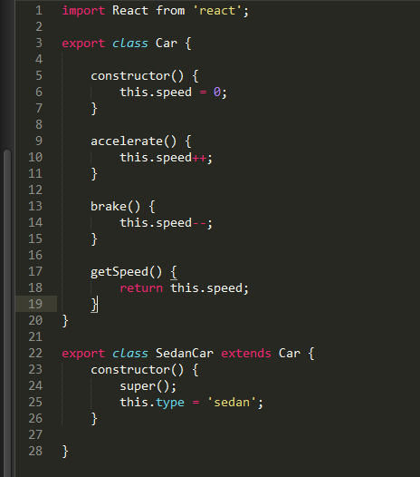
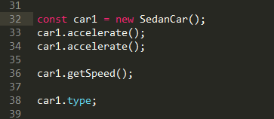
Inheritance

Slide 11
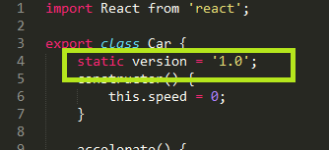
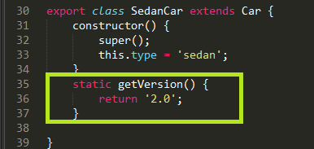
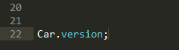
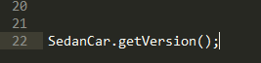
Static properties and methods

Slide 12
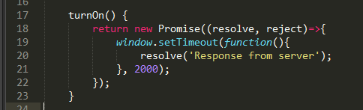
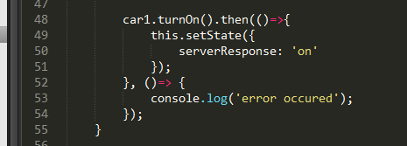
Promises

Slide 13
Why React?
Simplicity
ReactJS is just simpler to grasp right away. The component-based approach, well-defined lifecycle, and use of just plain JavaScript make React very simple to learn
Easy to learn
Anyone with a basic previous knowledge in programming can easily understand
Native Approach
React can be used to create mobile applications (React Native).
Data Binding
React uses one-way data binding and an application architecture called Flux controls the flow of data to components through one control point
Testability
ReactJS applications are super easy to test. React views can be treated as functions of the state, so we can manipulate with state we pass to the ReactJS view

Slide 14
Introduction ReactJS
ReactJS basically is an open-source JavaScript library
It is used for building user interfaces specifically for single page applications
In React, instead of using regular JavaScript for templating, it uses JSX.
Single-Way data flow In React, a set of immutable values are passed to the components renderer as properties in its HTML tags.
Virtual Document Object Model React creates an in-memory data structure cache which computes the changes made and then updates the browser.

Slide 15
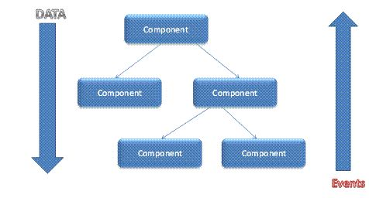
Single-Way data flow

Slide 16
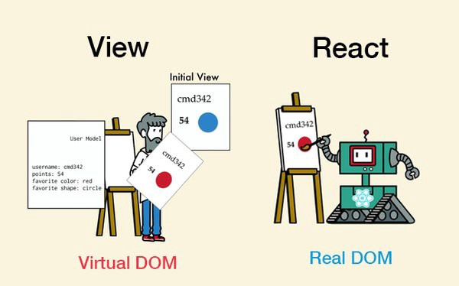
Virtual Document Object Model

Slide 17
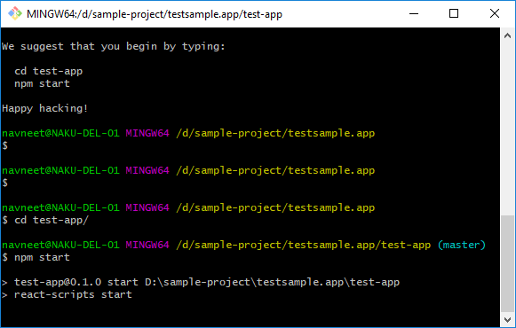
Just React
Hello World
Should have nodejs, npm
Open command window
Npm install -g create-react-app
create-react-app <app-name>
Cd <app-name>
Npm start

Slide 18
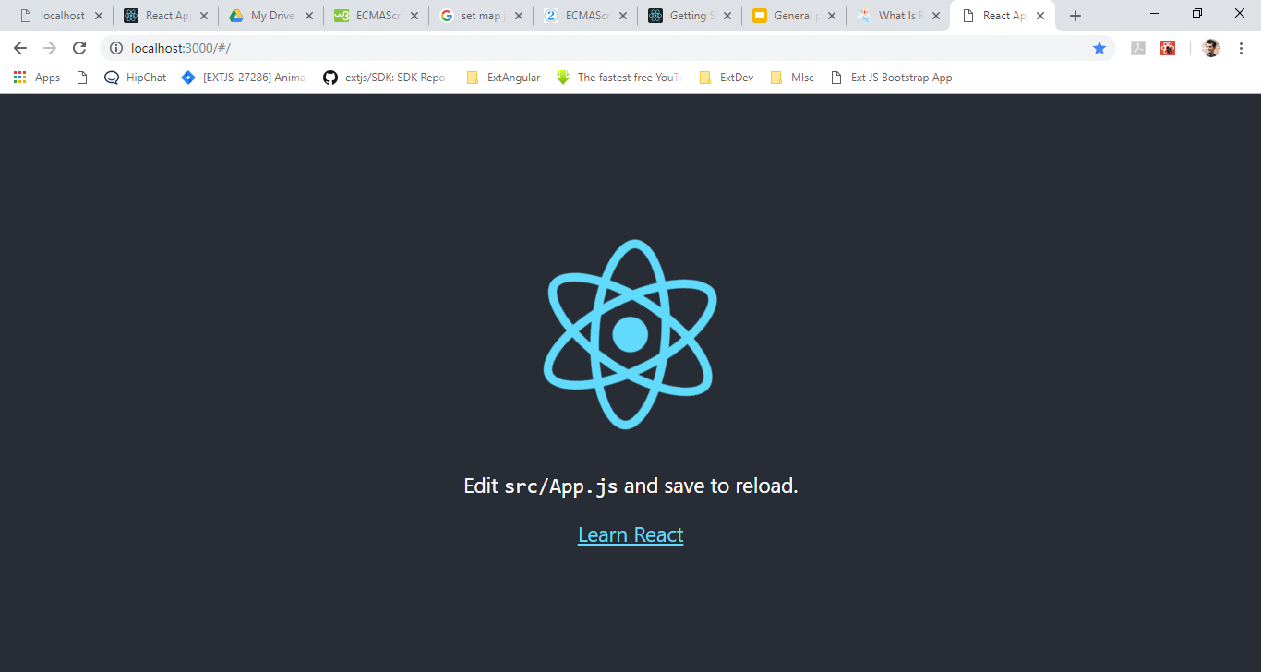
Running the app

Slide 19
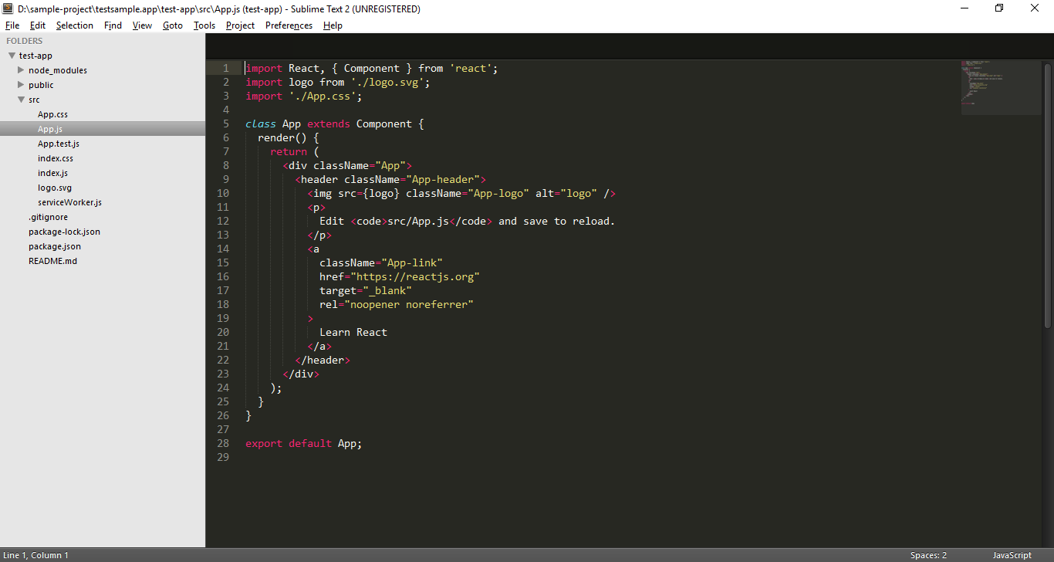
Folder structure

Slide 20
Modify and Debugging App

Slide 21
Hands on samples
Dom manipulation
Events listeners
JSX

Slide 22
React scripts
Using default react webpack scripts
Manual configuration
Npm run eject
/scripts
Webpack dev server
/config

Slide 23
Npm scripts (package.json)
Start
Build
Test

Slide 24


Slide 25
“Engineers like to solve problems. If there are no problems handily available, they will create their own problems”
— Scott Adams

Slide 26


Thanks!
Please feel free to ask any questions.
Navneet Kumar
navneet.kumar@accoliteindia.com

